Slide 2
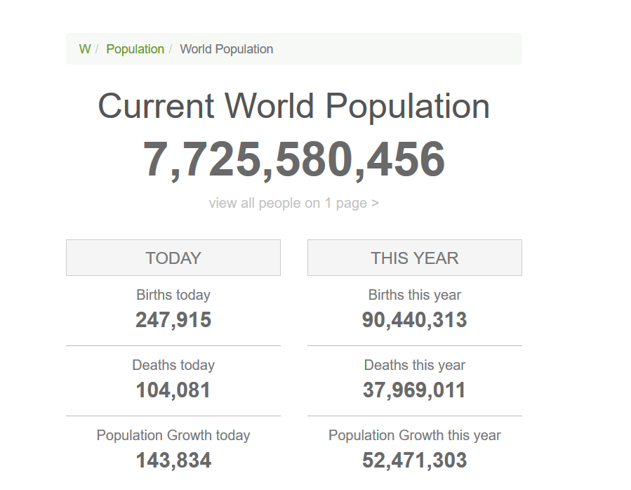
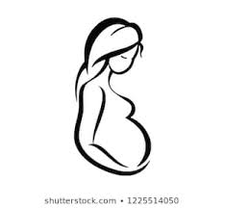
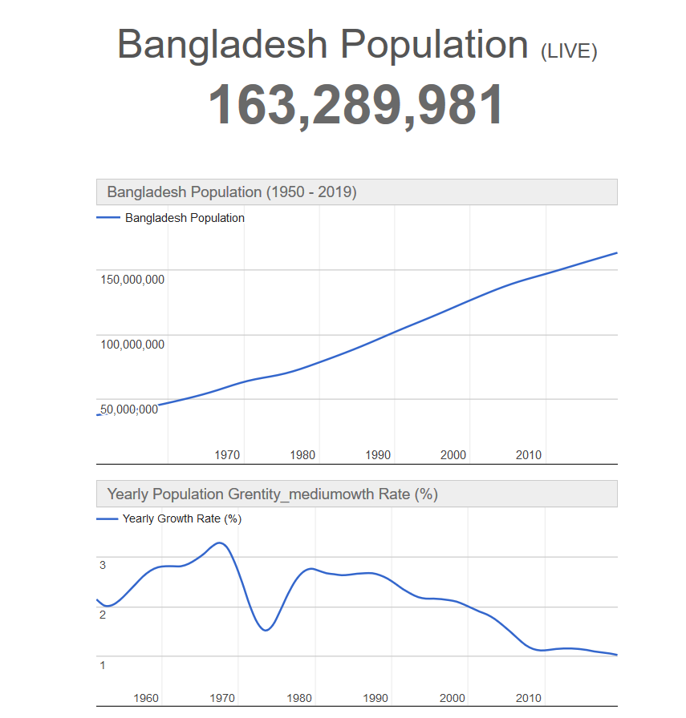
Statistics:
The estimated 211 million pregnancies that occur each year globally.
Each year an estimated 123 million succeed
Source: World Health Organization
https://www.who.int/whr/2005/chapter3/en/index3.html
In Bangladesh, around 2.8 million women gets pregnant.
But only 2.6 millions babies are born.
50% of the mothers had to give birth at home.
55% of the mothers are under 18 Years of age.
Source: Success Factors for Women’s and Children’s Health, WHO
Bangladesh Statistics, Bangladesh Bureau of Statistics (BBS),
Statistics and Informatics Division (SID), Ministry of Planning
8,400 babies were born in 1st of January.2019[Source: Dhaka Tribune]
Source: https://www.worldometers.info/world-population (time:3:49 PM Date: 24.08.2019

Slide 3
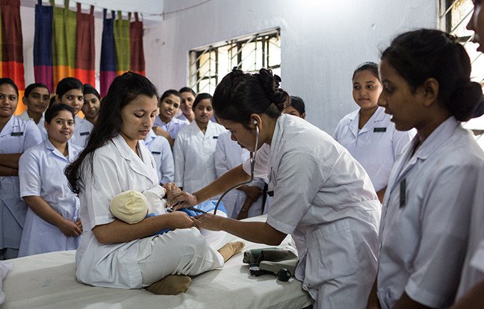
A Pregnant Mother needs some monitoring and tests during the period.
Ultrasound test for fetal nuchal translucency
Pregnancy-associated plasma protein screening
Human chorionic gonadotropin
Alpha-fetoprotein screening
Amniocentesis
Chorionic villus sampling
Fetal monitoring

Slide 4
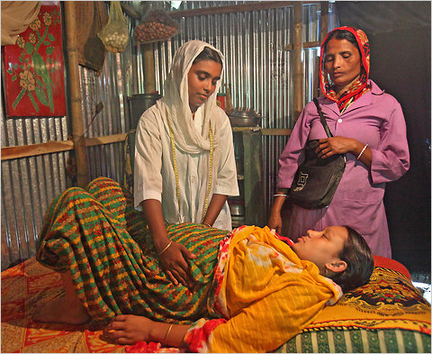
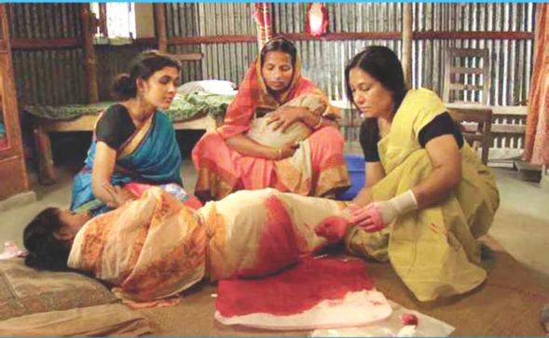
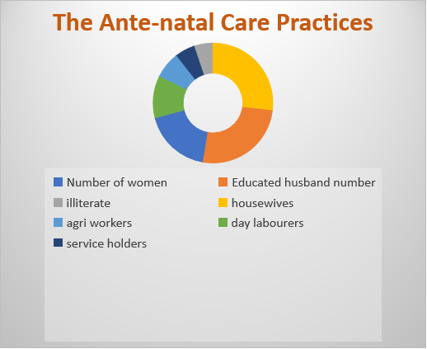
In the rural areas of our country, The Ante-natal Care Practices

